Slide 1
CLASS B AMPLIFIER OPERATION
Page 693 -703

Slide 2
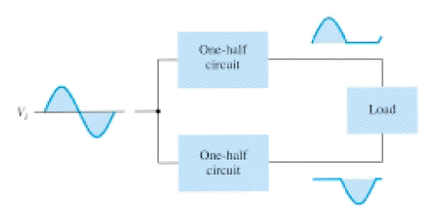
the class B operation of these transistors provides greater efficiency than
was possible using a single transistor in class A operation.
Block
representation of push-pull
operation.

Slide 3
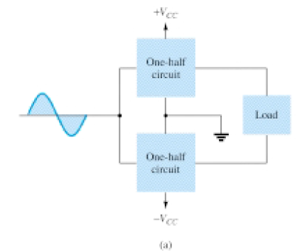
Input (DC) Power
where Idc is the
average or dc
current drawn
from the power
supplies.

Slide 4
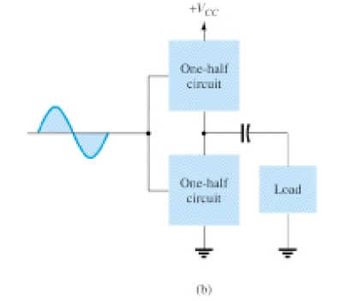
Figure 16.13 Connection of push-pull amplifier to load: (a) using two voltage
supplies; (b) using one voltage supply.

Slide 5
the current drawn from a single power supply has the form of a full-wave rectified signal,
while that drawn from two power supplies has the form of a half wave rectified signal from each supply
the average current drawn is:
where I(p) is the peak value of the output current waveform.

Slide 6
Output (AC) Power
If one is using an oscilloscope, the peak, or peak-to-peak, output voltage measured
can be used:
The larger the rms or peak output voltage, the larger the power delivered to the load.

Slide 7
Efficiency
The efficiency of the class B amplifier can be calculated using the basic equation

Slide 8
the larger the peak voltage, the higher the circuit efficiency, up to a maximum value when VL(p) = VCC, this maximum efficiency then being
Power Dissipated by output Transistor
The power dissipated (as heat) by the output power transistors is the difference between the input power delivered by the supplies and the output power delivered to the load.

Slide 9
where P2Q is the power dissipated by the two output power transistors. The dissipated power handled by each transistor is then

Slide 10
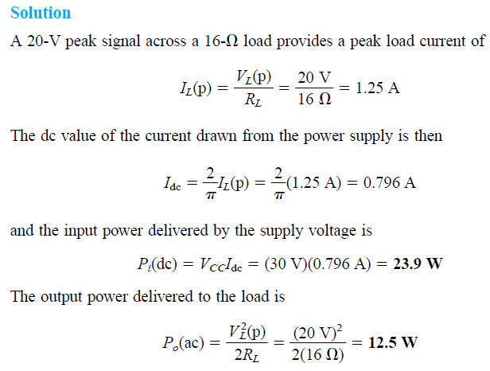

Slide 11
Maximum Power Considerations
For class B operation, the maximum output power is delivered to the load when
VL(p) = VCC:

Slide 12
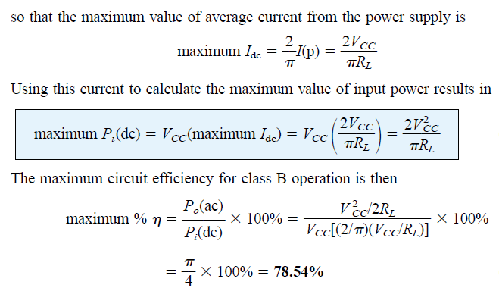

Slide 13
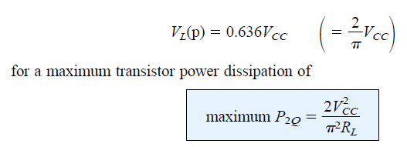
For class B operation, the maximum power dissipated by the output transistors does not occur at the maximum power input or output condition. The maximum power dissipated by the two output transistors occurs when the output voltage across the load is

Slide 15
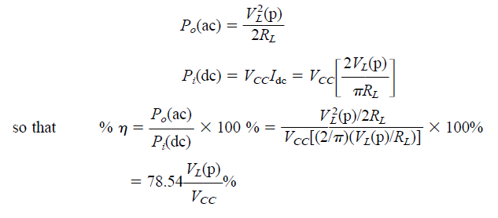
The maximum efficiency of a class B amplifier can also be expressed as follows:

Slide 16
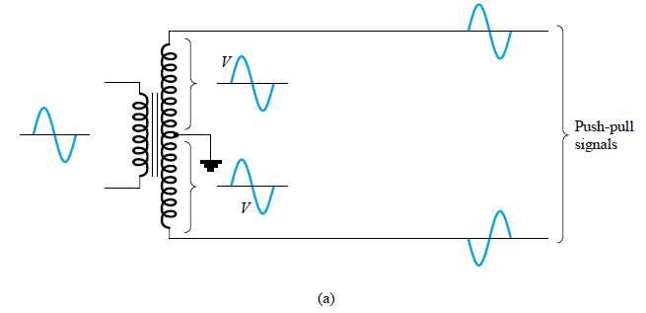
CLASS B AMPLIFIER CIRCUITS
Figure 16.14 shows different ways to obtain phase-inverted signals from a single input signal.
Figure 16.14a shows a center-tapped transformer to provide opposite phase signals. If the transformer is exactly center-tapped, the two signals are exactly opposite in phase and of the same magnitude.

Slide 17
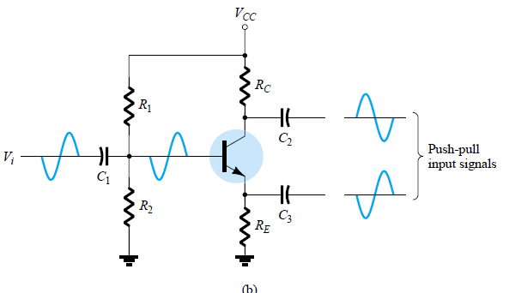
Fig. 16.14b uses a BJT stage with in-phase output from the emitter and opposite phase output from the collector. If the gain is made nearly 1 for each output, the same magnitude results.

Slide 18
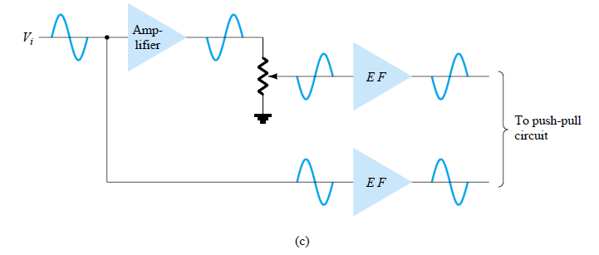
Probably most common would be using op-amp stages, one to provide an inverting gain of unity and the other a noninverting gain of unity, to provide two outputs of the same magnitude but of opposite phase

Slide 19
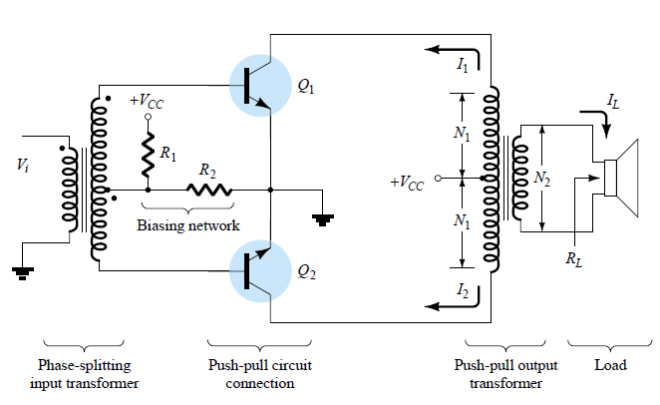
Transformer-Coupled Push–Pull Circuits

Slide 20
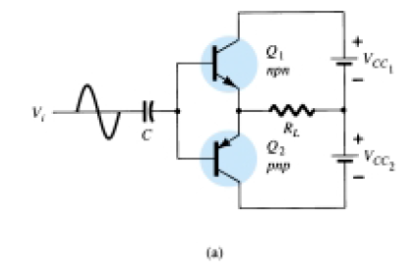
Complementary-Symmetry Circuits

Slide 21
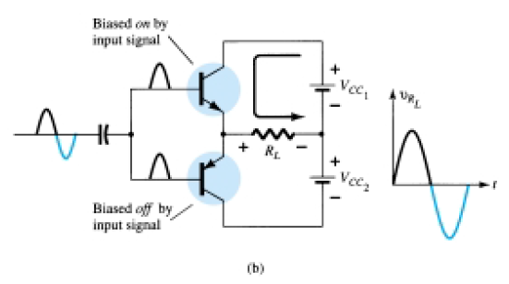

Slide 22
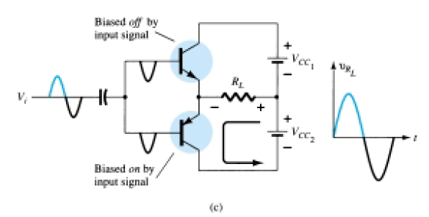
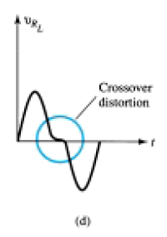

Slide 23
During a complete cycle of the input, a complete cycle of output signal is developed across the load.
One disadvantage of the circuit is the need for two separate voltage supplies.
Another, less obvious disadvantage with the complementary circuit is shown in the resulting crossover distortion in the output signal (see Fig. 16.16d).
Crossover distortion refers to the fact that during the signal crossover from positive to negative (or vice versa) there is some nonlinearity in the output signal. This results from the fact that the circuit does not provide exact switching of one transistor off and the other on at the zero-voltage condition. Both transistors may be partially off

Slide 24
so that the output voltage does not follow the input around the zero-voltage condition.
Biasing the transistors in class AB improves this operation by biasing both transistors to be on for more than half a cycle.

Slide 25
A more practical version of a push-pull circuit using complementary transistors is shown in Fig. 16.17. Note that the load is driven as the output of an emitter follower
so that the load resistance of the load is matched by the low output resistance of the driving source.
The circuit uses complementary Darlington-connected transistors to provide higher output current and lower output resistance.

Slide 26
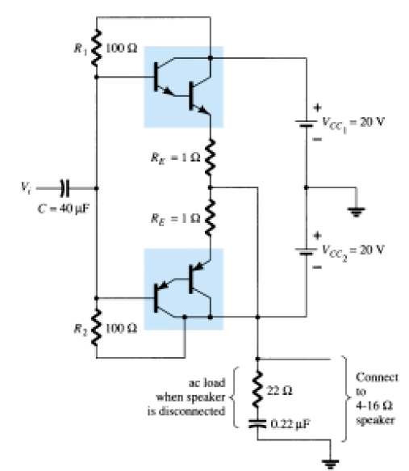

Slide 27
Quasi-Complementary Push–Pull Amplifier
In practical power amplifier circuits, it is preferable to use npn transistors for both high-current-output devices.
Since the push-pull connection requires complementary devices, a pnp high-power transistor must be used.
A practical means of obtaining complementary operation while using the same, matched npn transistors for the output is provided by a quasi-complementary circuit, as shown in Fig. 16.18.

Slide 28
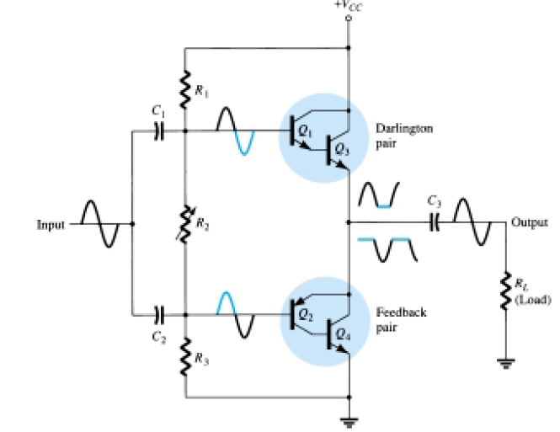
Resistor R2 can be adjusted to minimize crossover distortion by adjusting the dc bias condition.

